Slide 1

Big fashion group sales report
Created by Reina

Slide 2
Table of Contents
Aim
Introduction
Problem statements
Conclusion

Slide 3

aim
To create a report based on Big Fashion Group sales dashboard

Slide 4

Introduction
This dataset encompasses the sales records of the Big Fashion Group from 2015 to 2019, including data from Next Look, Fashion Direct, and all other chains under the Big Fashion Group.

Slide 5
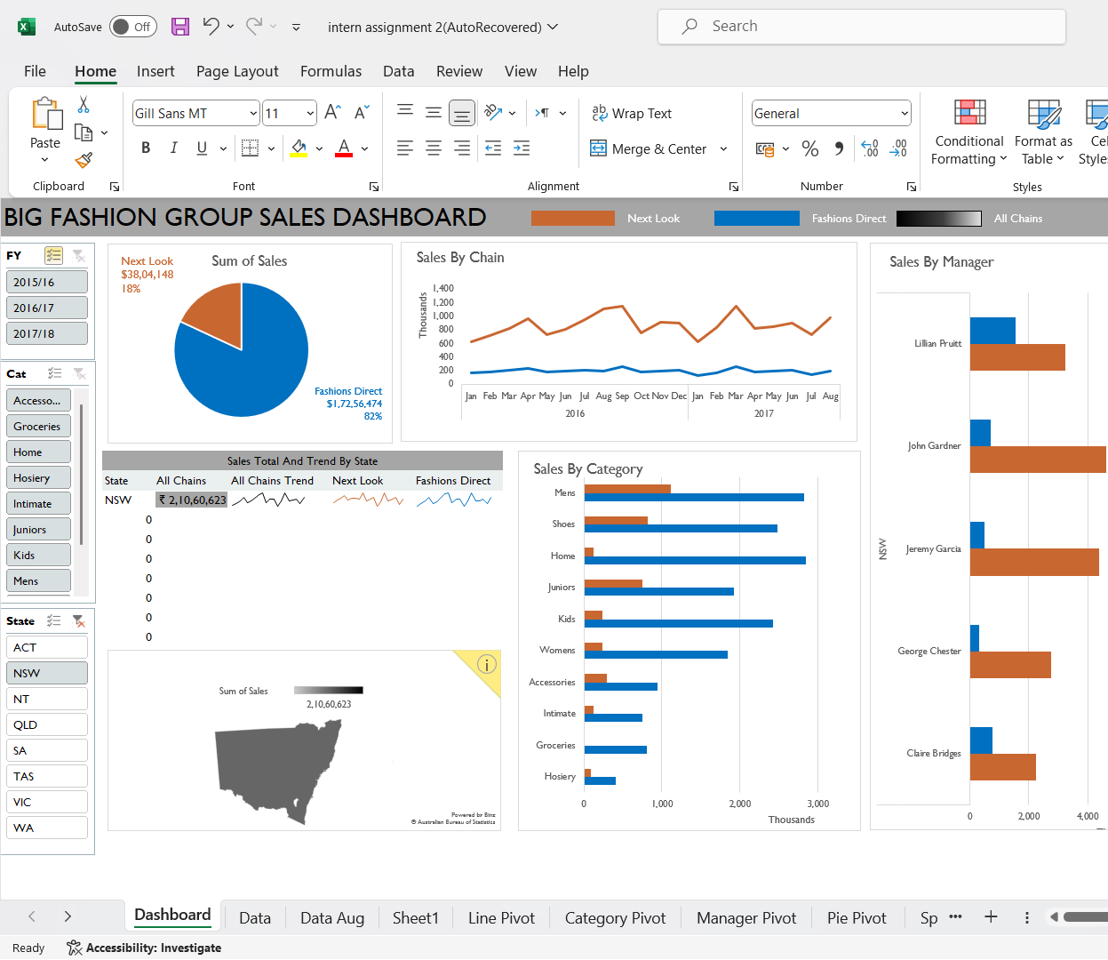
Problem 1
Which state has the highest total sales across all chains ?
Ans: NSW
(2,10,60,623 RS)

Slide 6
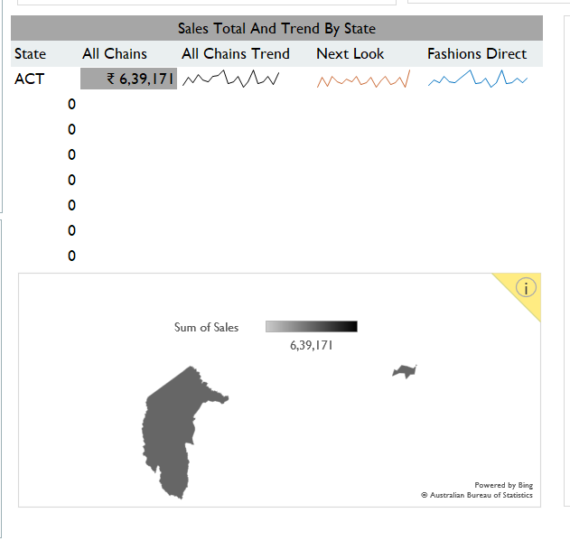
Problem 2
Which state has the least sales across all chains ?
Ans:(2,10,60,623 RS)

Slide 7
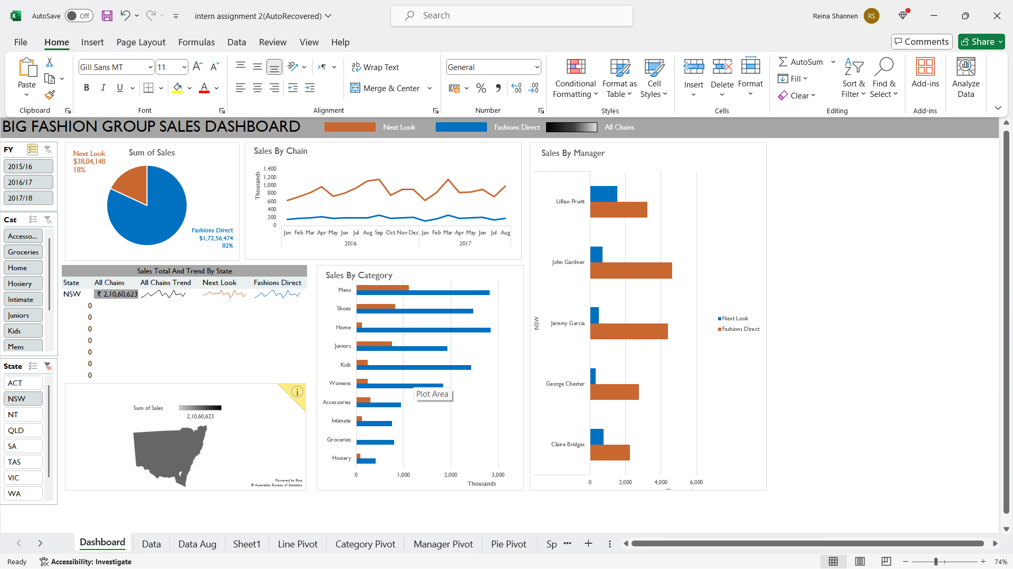
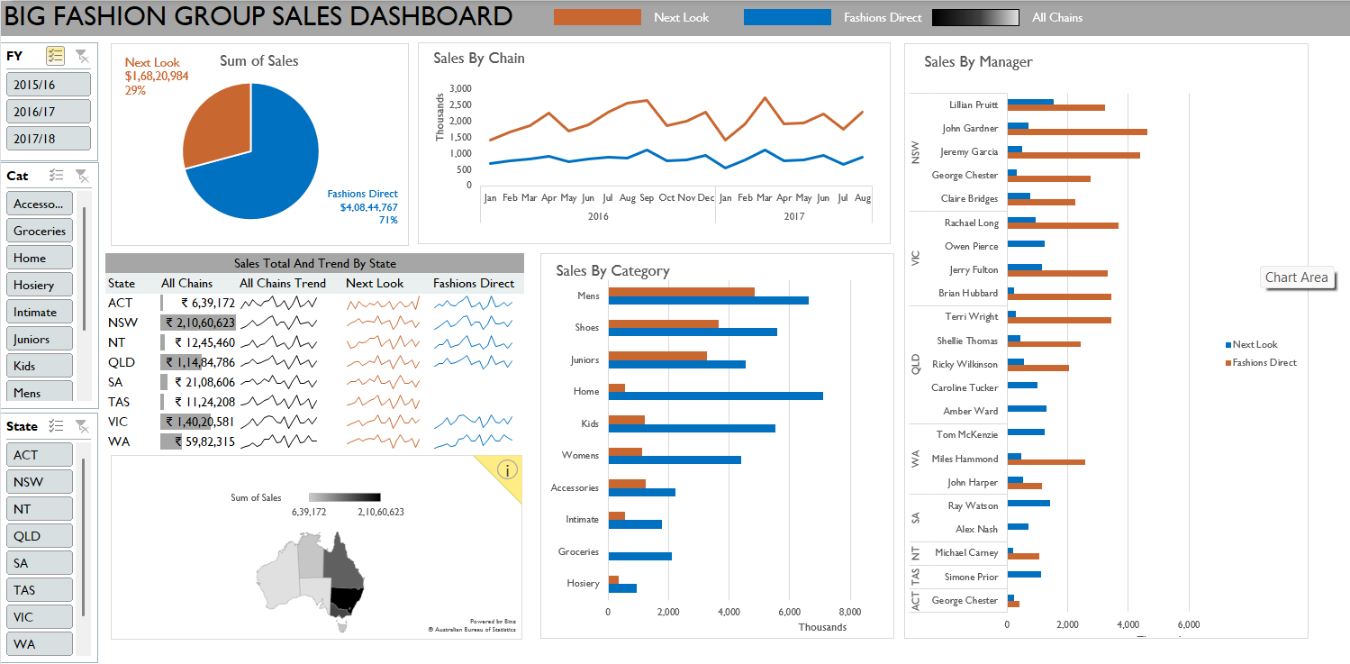
Problem 3
Which manager has the highest sales in Next Look and the manager that has the highest sales in Fashions Direct?
Lillian Pruitt(Next Look)
John Gardener(Fashions Direct)

Slide 8
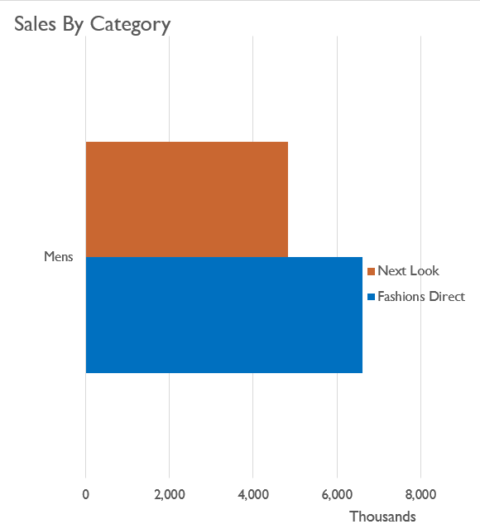
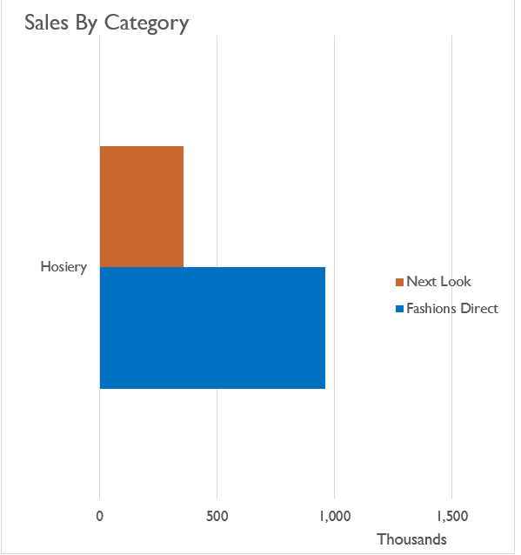
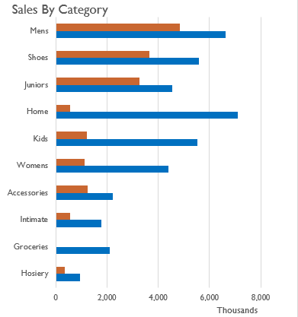
Problem 4
Which category has the most and least sales?
Mens (Highest)
Hosiery (Least)

Slide 9
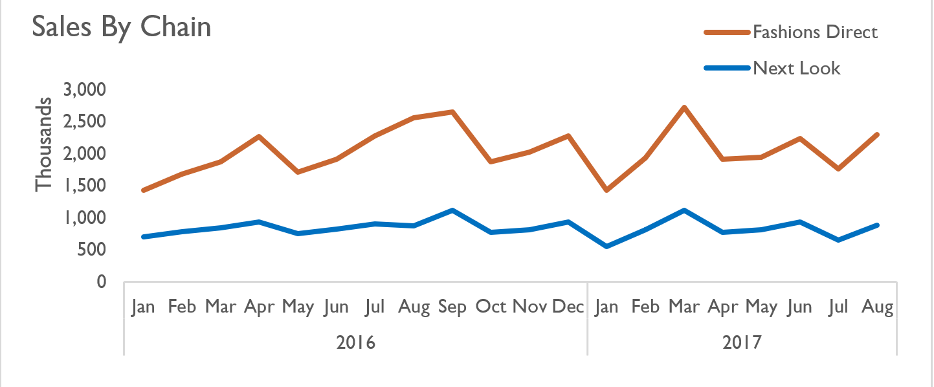
Problem 5
How was the overall sales trend from 2015-2018?
Overall, Fashions Direct has had higher sales than Next Look.
While Fashions Direct experienced sharp fluctuations, especially in
January and February ,Next Look's sales remained consistent without significant ups and downs.

Slide 10

Conclusion
This dashboard effectively visualizes the total sales performance of the Big Fashion Group from 2015 to 2018
It facilitates detailed analysis of sales trends on a monthly basis, providing valuable insights into seasonal variations and long-term patterns.
Additionally, it presents consolidated sales figures across different groups or categories, enabling a comprehensive overview of performance metrics.

